Slide 1
Ada Boosting

Slide 2
Adaptive learning
Adaptive learning
Ensemble learning
Ensemble learning
Meta learning
Meta learning

Slide 3
Supports both regression and classification
Feature Engineering
Supervised learning algorithm
Intrinsically sequential

Slide 4
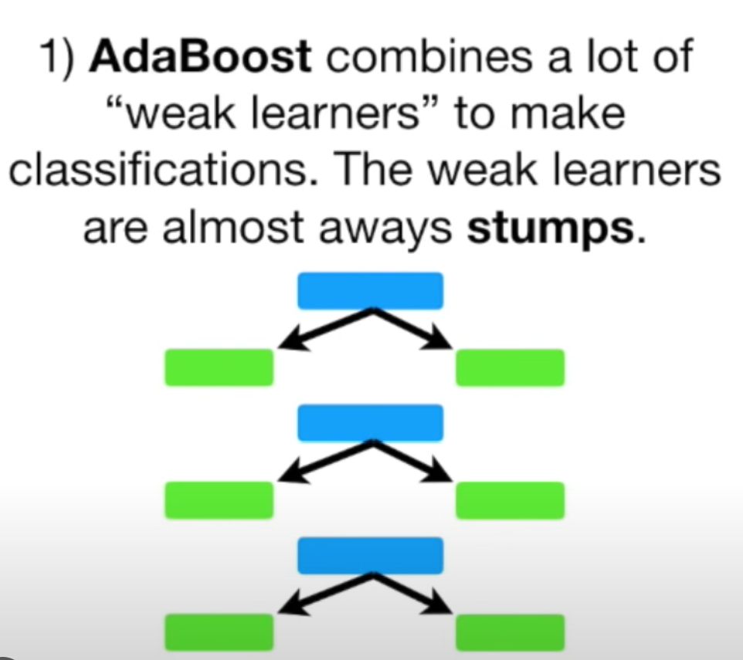
Combines multiple weak learners into a strong learners

Slide 5
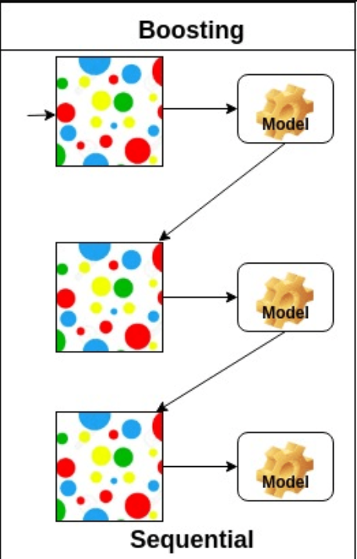
More resistant to overfitting
Accuracy of weak classifiers can be improved

